Slide 1

CAPSTONE
WARM UP

Slide 2
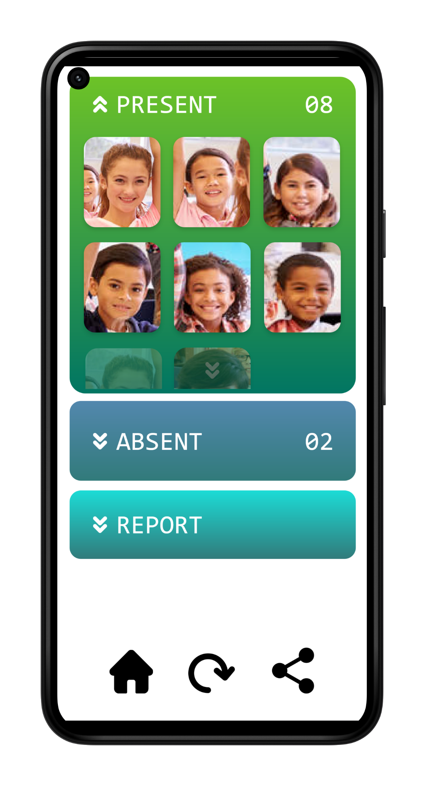
FAST
ACCURATE
DEPENDABLE
FACESHOT

Slide 3
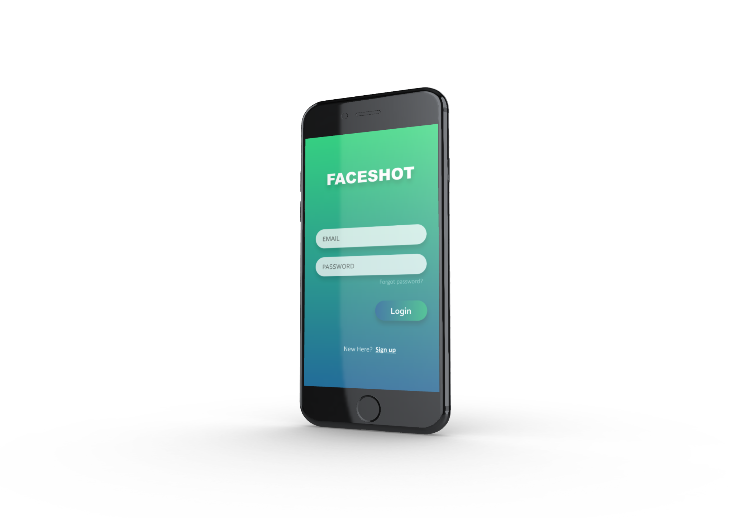
SCOPE
The scope of this project is to develop a mobile
application that uses face recognition
to mark the attendance of a class
with a single photograph.

Slide 4

FLOW
DIAGRAM

Slide 5
Server
Image is compressed and sent to the server.
Images are received and pre-processed.
Face Detection Module detects faces
Face recognition modules identifies faces.
Teacher clicks a photo using our app.
Confidences are thresholded and a final list is compiled and saved.
Students receive push notifications.
Attendance information is updated on the teacher’s phone

Slide 6


USE CASES
Teacher Application

Slide 7
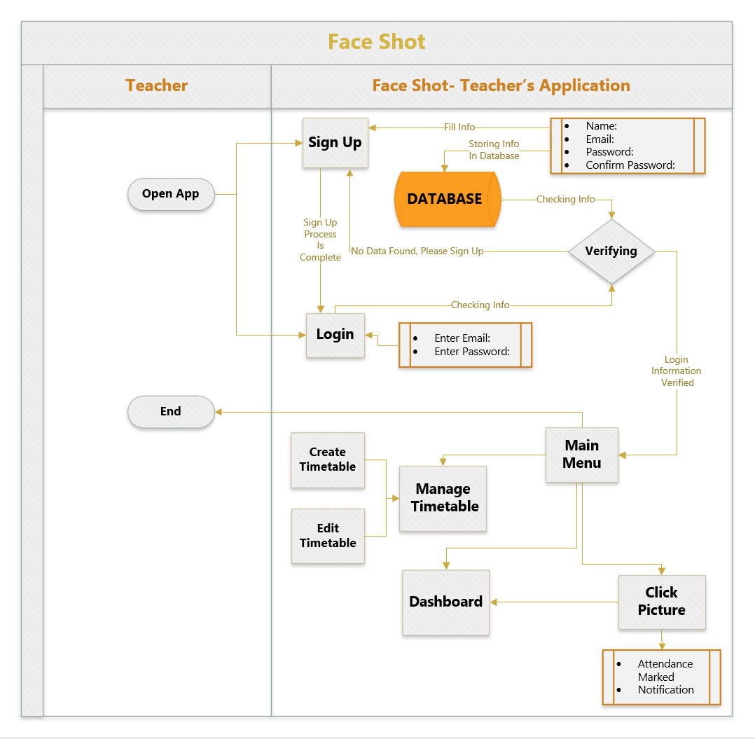

Slide 8
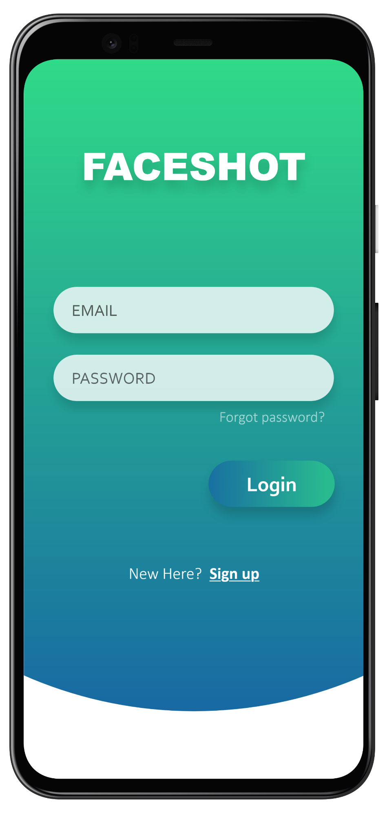
Use Case 1 | Login
Actor | User (Teacher)
The user launches the app and is greeted by the login page. The user enters the login credentials, and if the credentials are correct, the user is granted access to the application.
Alternate Flow 1A | If the user does not have a registered account, they click on the sign-up button.
Alternate Flow 1B | If he is unable to recall the credentials, he presses the forgot password link.

Slide 9
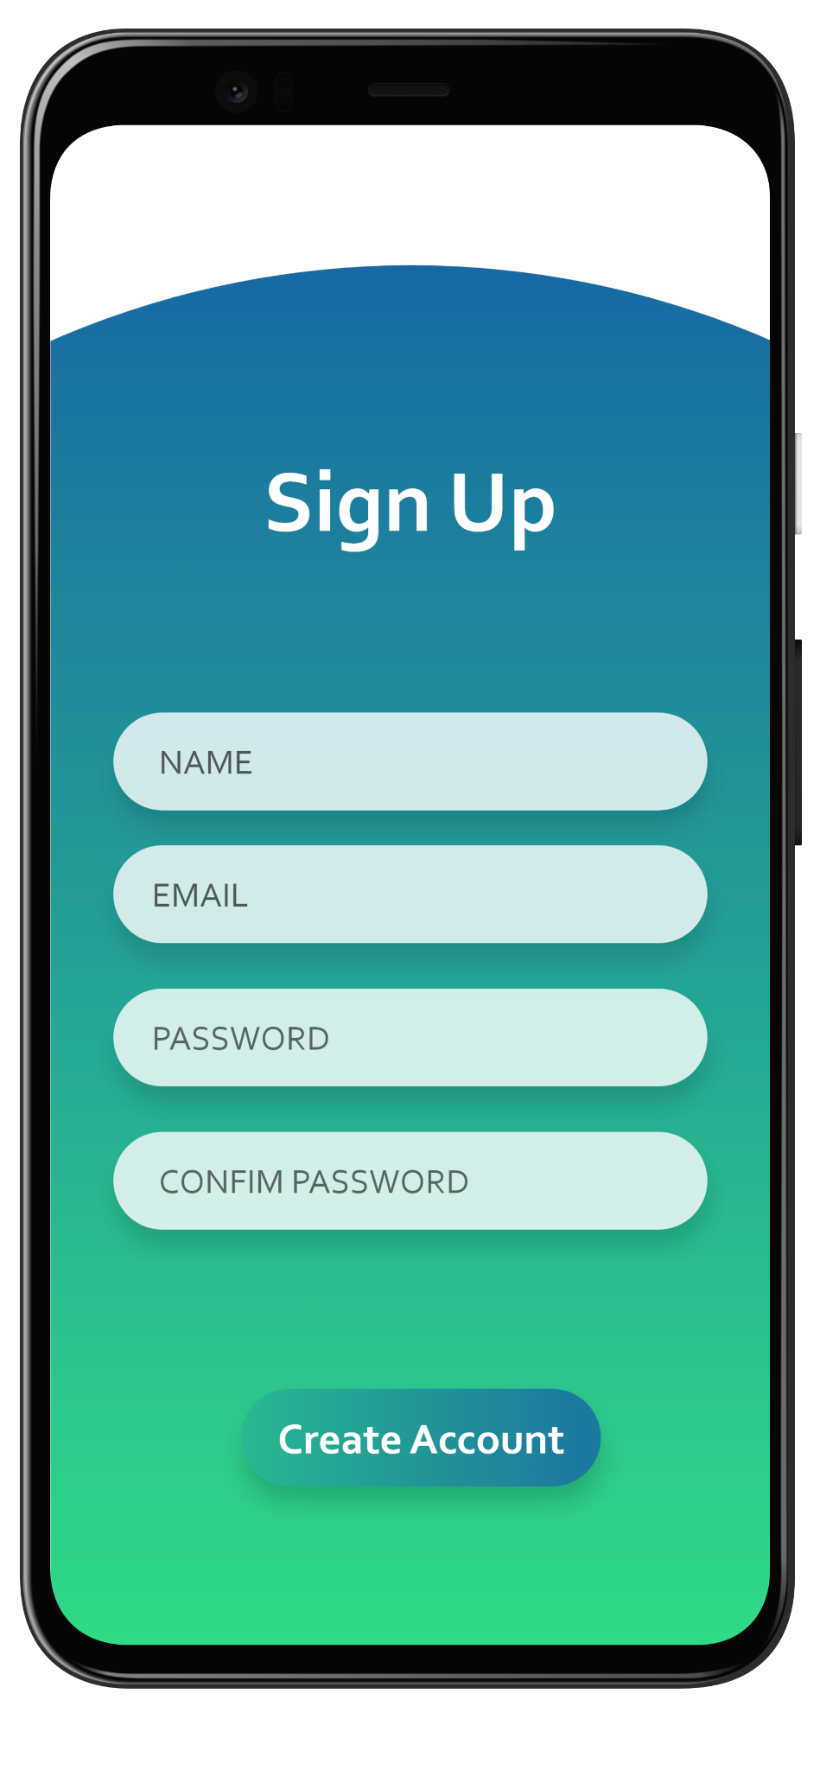
Use Case 1A | Signup & Onboarding
Actor | User (Teacher)
When the user clicks “Create Account”, button, the user is taken to the signup page. Were the user fills in the information such as email, password and completes the account setup. Email address and password would be stored in the database. Then the user chooses a timetable for his subject, where they input the name of the subject, and select the time slots for the classes.

Slide 10
Use Case 1B | Forgot Password
Actor | User
When user clicks on forgot password, enters forgot password page. User needs to enter the email to reset the password. The password reset link will be sent to the email address. Then user needs to enter new password and confirm the new password. The new password would be updated in the database.

Slide 11
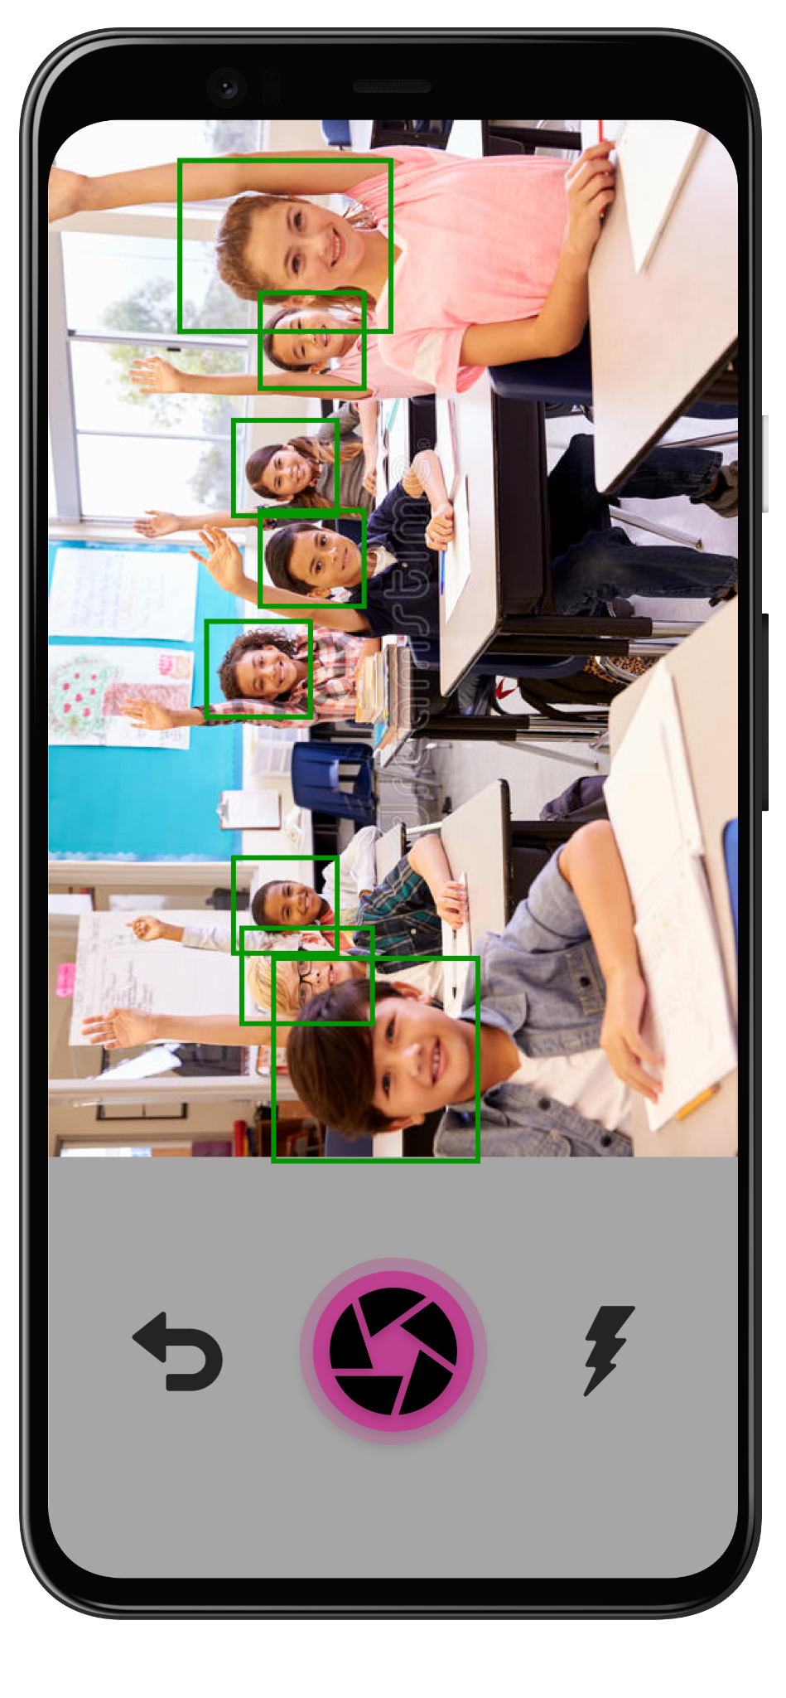
Use Case 2 | Take Attendance
Actor | User (Teacher)
The teacher selects the Snap picture icon in the Current Class section, and the camera opens up. The teacher takes a clear picture. This picture is sent to the server to our AI model, and all faces are detected, and the attendance is taken successfully. After completion, the user is redirected to the attendance page.
Alternate Flow 2A | In case of an error, the user is prompted to retake the picture.

Slide 12
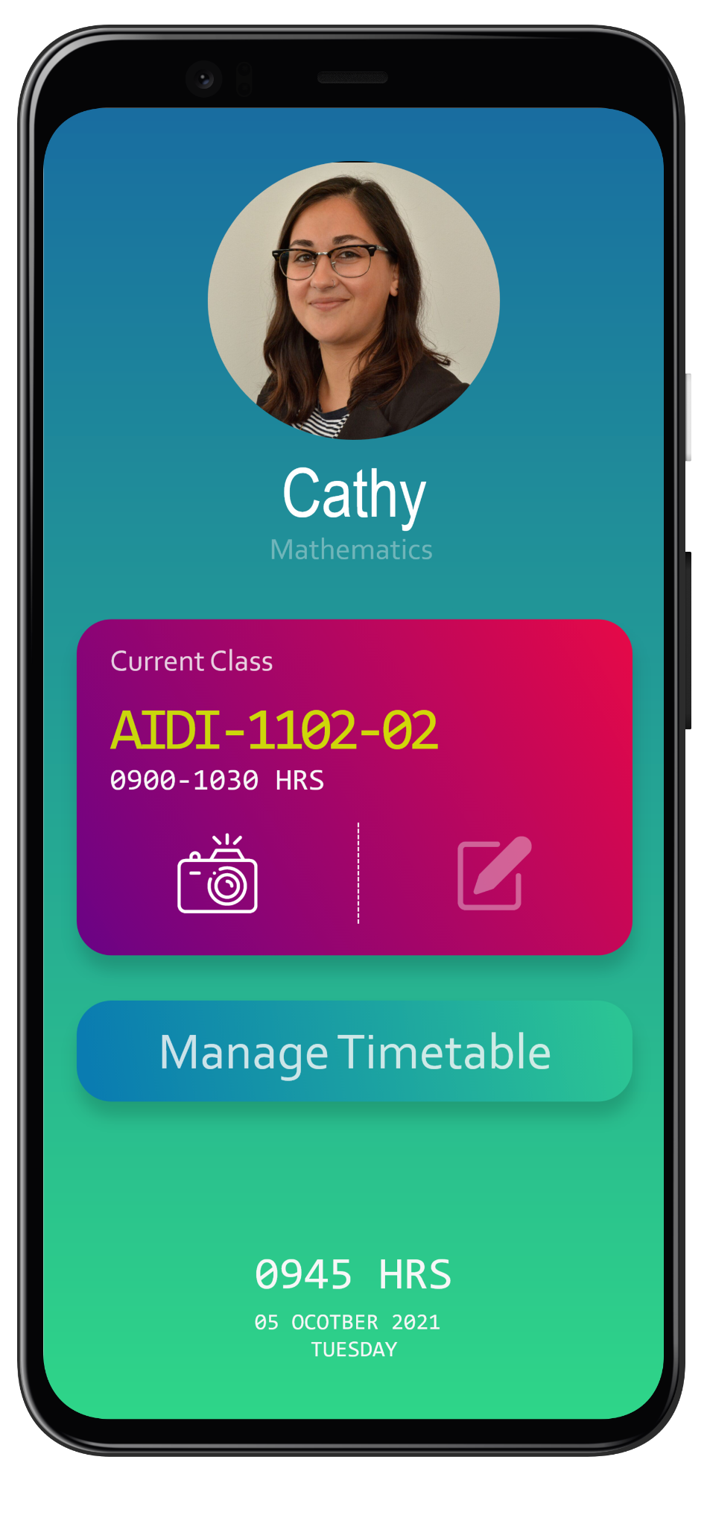
Use Case 3 | Edit Attendance
Actor | User (Teacher)
On the home page, the user clicks the dashboard button under the Current Class section to access the current attendance dashboard.
Alternate Flow 3A | Dashboard button is inactive. If no previous attendances were taken, the dashboard button will be inactive, and he will have to take attendance to unlock the dashboard.
Alternate Flow 3B | For already taken attendance, allow the teachers to modify this day’s taken attendances manually.
Alternate Flow 3C | Third option for teacher is to view their timetable

Slide 13
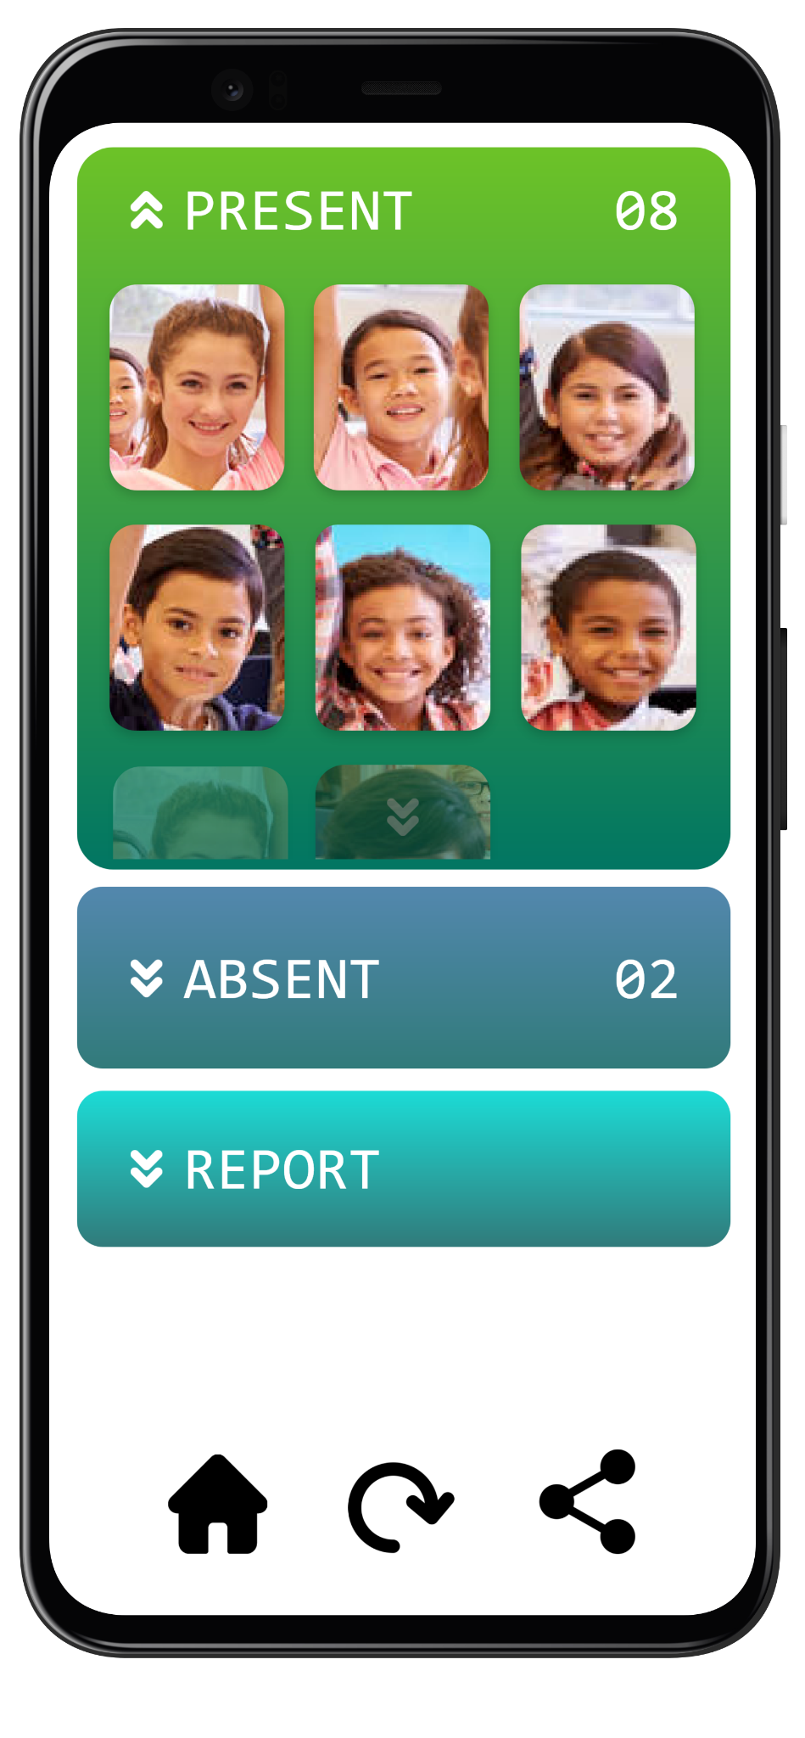
Use Case 3B | Edit Attendance
Actor | User (Teacher)
The teacher sees the list of all the present students, and are able to modify the attendance manually.

Slide 14
Use Case 3C | View Timetable
Actor | User (teacher)
The teacher is able to view their already created timetable.

Slide 15
USE CASES
Student Application

Slide 16
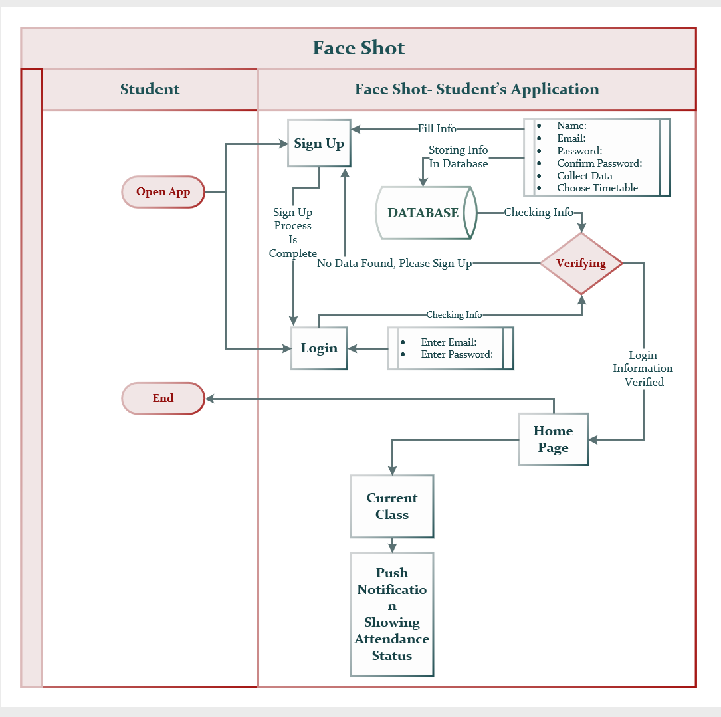

Slide 17
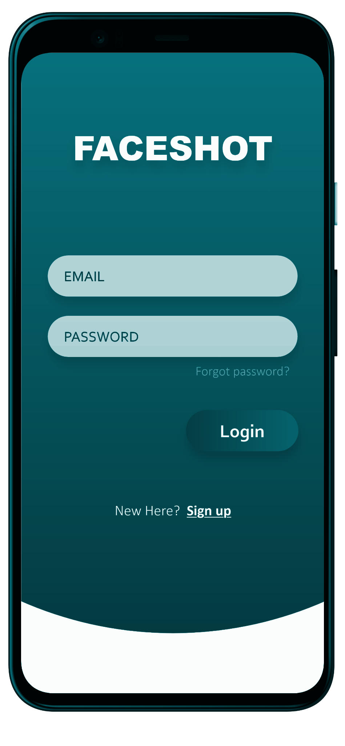
Use Case 1 | Login
Actor | User (Student)
The user launches the app and is greeted by the login page. The user enters the login credentials, and if the credentials are correct, the user is granted access to the application.
Alternate Flow 1A | If the user does not have a registered account, they click on the sign-up button.
Alternate Flow 1B | If he is unable to recall the credentials, he presses the forgot password link.

Slide 18
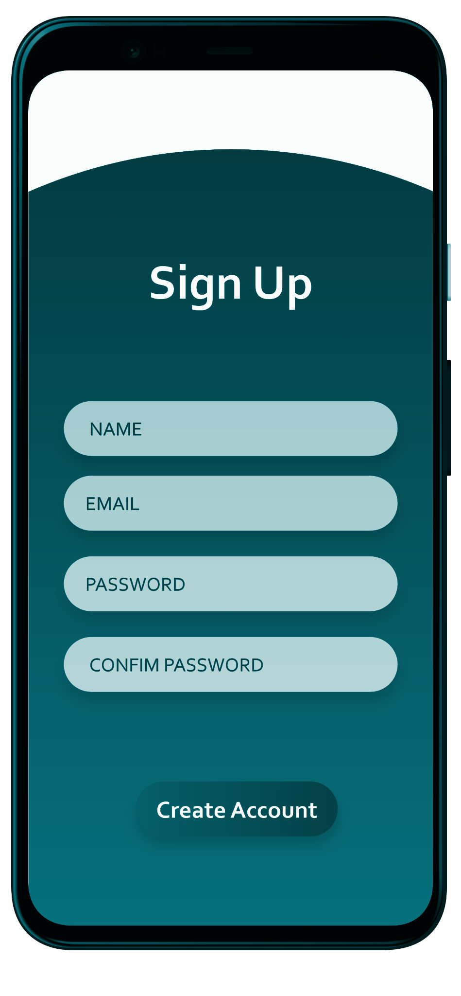
Use Case 1A | Signup
Actor | User (Student)
When user opens the app first time to create the account, user fills in the information such as Name, Email, Password and completes the account setup. All the details would be stored in the database. The user has to complete the mandatory step of scanning face for images and selecting a timetable before going to the Home page.

Slide 19
Use Case 1B | Forgot Password
Actor | User (Student)
User needs to enter the email to reset the password. The input email id will be checked against the system records. If present, the password reset link will be sent to the email address. Then user needs to enter new password and reenter to confirm the new password. The new password would be updated in the database.

Slide 20
Use Case 2 | View current class details.
Actor | User (Student)
In the home page, the user will be able to see the current class details.

Slide 21

TECH STACK

Slide 22


Front End (Mobile app)
Framework: Flutter
Language: Dart

Slide 23


Communication
Framework: Flask
Language: Python

Slide 24


Computer
Vision
Framework: Tensorflow
Language: Python
Framework: OpenCV

Slide 25


Database, Auth, Cloud
Framework: Firebase
Platform: GCP

Slide 26

Version Control

Slide 27
THANK YOU
Abhishek Joshi
Jerin Mathew
Praharsh Bhatt
Pruthviben Patel
Ram Raghu Sankar

